Slide 1


Procedural Programming
Khushi Tiwari
FYBSc.IT
A-13

Slide 2
Procedural programming is a programming paradigms based upon the concept of the procedural call.
As procedural programming language follows a method of solving problems from the top of the code to the bottom of the code, if a change is required to the program, the developer has to change every line of code that links to the main or the original code.
If the user wants to code a program, they would have to follow a sequence of instructions and thereby enter the instructions.
Procedural programming focuses on processes. In procedural programming data and functions are stored in separate memory location,while in OOP data and functions are stored in same memory location.
Programs are made up of modules, which are parts of a program that can be coded and tested separately, and then assembled to form a complete program.
Examples for procedural programming languages include C,C++, COBOL, FORTRAN and VB.

Slide 3
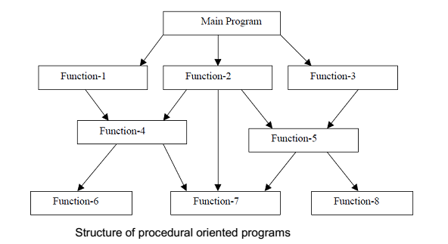
Structure of Procedural Oriented Programming

Slide 4
The design method used in procedural programming is called Top Down Design.
This is where you start with a problem (procedure) and then systematically break the problem down into sub problems (sub-procedures).
This is called functional decomposition, which continues until a sub-problem is straightforward enough to be solved by the corresponding sub-procedure.
When changes are made to the main procedure (top), those changes can cascade to the sub procedures of main, and the sub-sub procedures and so on, where the change may impact all procedures in the pyramid.
The problem with PP approach is its handling of data. PP approach gives no importance to data. By ‘data’ we mean the information collected from user, the new results obtained after calculations etc.

Slide 5
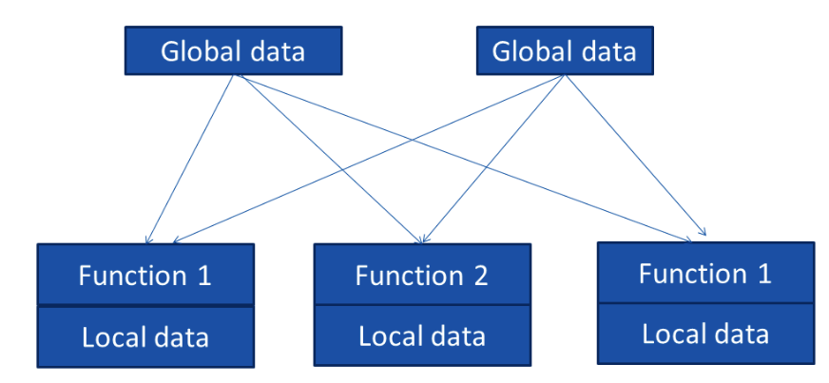
Global Data

Slide 6
Characteristics of procedure-oriented programming language:
It emphasis on algorithm (doing this ).
Large programs are divided into smaller programs known as functions.
Function can communicate by global variable.
Data move freely from one function to another function.
Functions change the value of data at any time from any place. (Functions transform data from one form to another.)
It uses top-down programming approach.

Slide 7
THANK YOU
FOR YOUR VALUABLE TIME

